Slide 1
Our approach to interactivity in data vis When less (interactivity) can be more
Peter Broad

Slide 2
Our context
Producing content for the ONS website
Primarily aimed at the ‘Inquiring Citizen’
Expert users will be able to download and explore the data – our charts do not have to showcase everything in the data
Context is really important

Slide 3
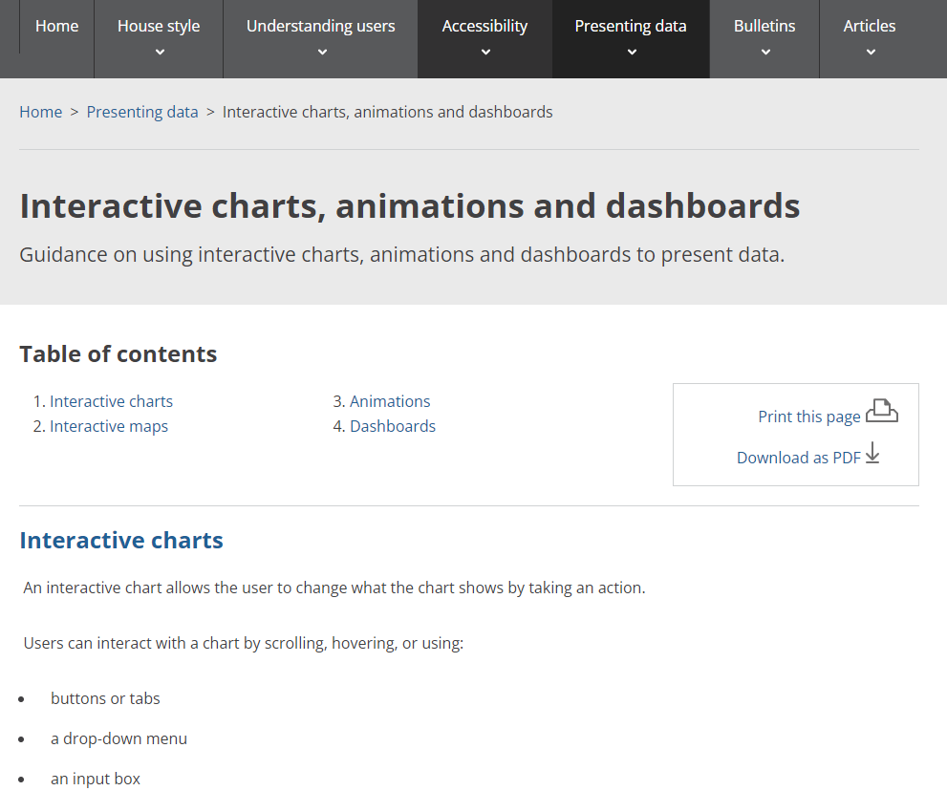
Our guidance
Style.ons.gov.uk

Slide 4
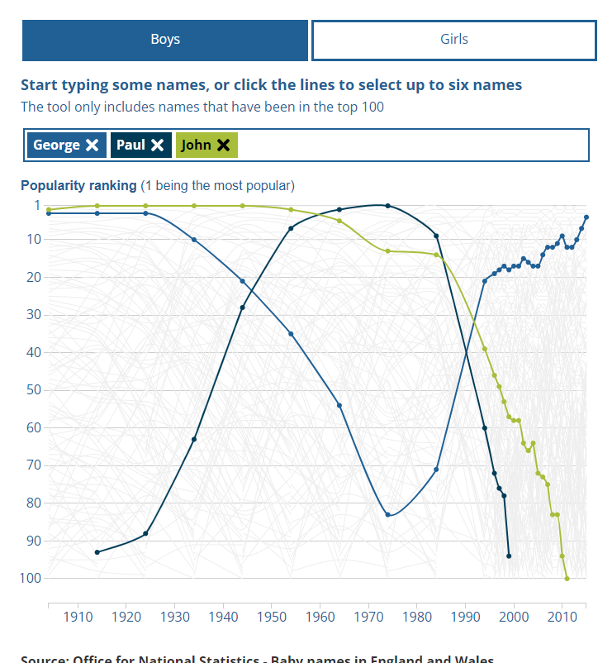
What is an interactive chart?
An interactive chart allows the user to change what the chart shows by taking an action.
Users can interact with a chart by scrolling, hovering, or using:
buttons or tabs
a drop-down menu
an input box
This does not include charts where the only interactive element is a tooltip or zoomable map. A tooltip displays data values when the user hovers over or selects part of a chart.

Slide 5
What about a dashboard?
A dashboard is a visual tool that shows different views of data to provide an overview of a specific topic.
will normally be a combination of several charts or important values. It is typically updated regularly or automatically, so a user can monitor it over time.
may or may not have interactive elements, such as filtering.

Slide 6
The drawbacks of interactive charts and dashboards
Interactive charts need the user to make a selection to see information. This may:
hide the main messages from users
make it more difficult for users to get messages
Likewise dashboards often put the burden of interpreting and understanding data onto the user
Not well-suited to data that need a large amount of explanation to be understood

Slide 7
…drawbacks of interactive charts and dashboards
They are also more complex and time consuming to produce
Dashboards can quickly become obsolete, as findings and user needs change
require a lot of maintenance if they need regular updating
are difficult to make accessible and responsive for different devices

Slide 8
An example: trade
Release on the impact of Brexit and coronavirus on trade in goods.
Rich data: Time series data on imports and exports across countries and different types of goods
Work on the assumption of minimal interaction

Slide 9
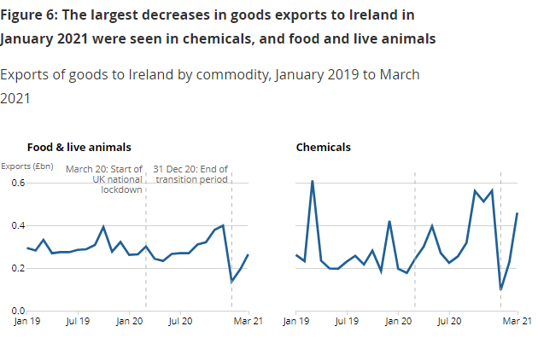
An example: trade

Slide 10
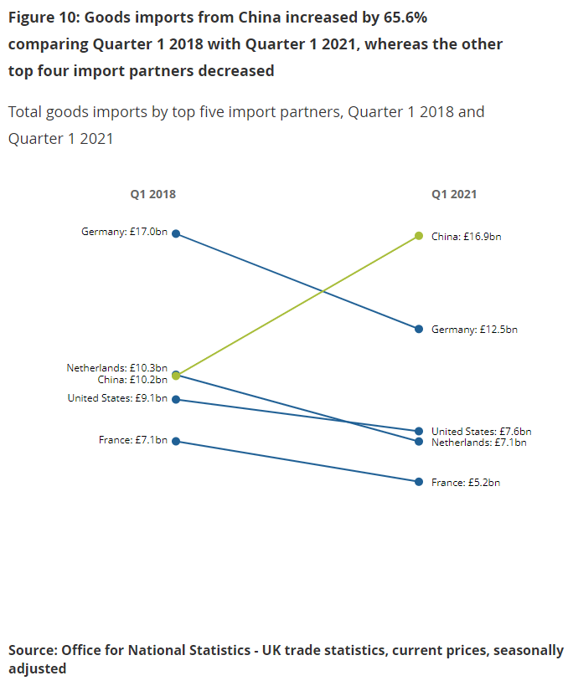
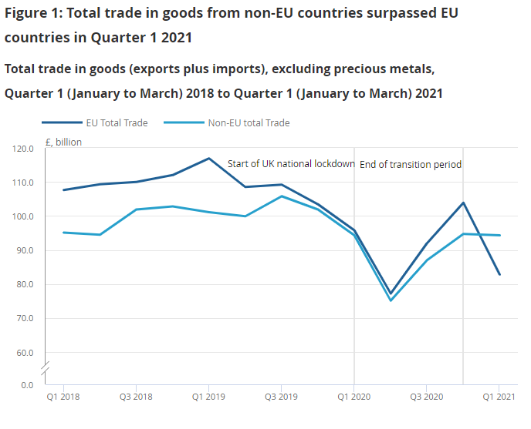
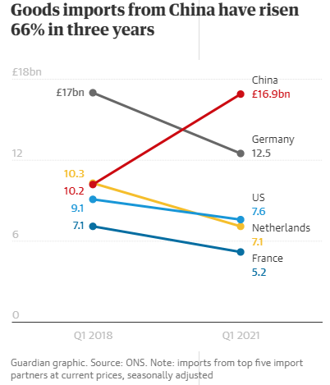
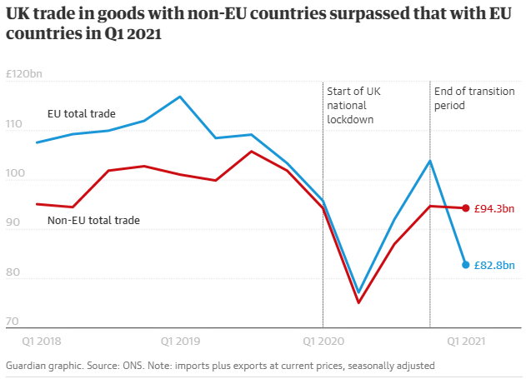
An example: trade

Slide 11
When we use an interactive chart
When the information that is most important for the user cannot be clearly shown through a non-interactive chart.
AND
There is a clear user need for an interactive chart
For example, census or COVID-19 data at a local level. In this case:
users are likely to be most interested in data about their local authority
there is not a clear way of displaying data for each local authority without interactivity

Slide 12
When to use a dashboard
Communicating high-level indicators; the more specific the issues and insights, the less likely it is that a dashboard will be useful
the topic is high-priority and users are likely to have some existing knowledge
the data are updated frequently, and users are likely to revisit the dashboard
the data can be updated automatically or with little extra work to avoid ongoing maintenance
Only use a dashboard if you have clear justification for doing so. This should be based on an understanding of your users’ needs.

Slide 13
When creating an interactive chart…
Only include data that will be important to your user.
Do not include all your data just because the interactive format allows it.
Design your chart in a way that helps the user get the most meaningful information, for example, by allowing the user to easily compare certain categories.
Provide context and help the user to navigate the data through annotations and the surrounding text.
Consider starting your visualisation from a view that either shows the main message without needing any interaction, or helps users navigate the chart.
Make sure the design of your interactive chart is consistent with relevant UX elements
Make clear how the user can interact (and why)

Slide 14
When creating a dashboard…
Put the most important insights at the top or in the most prominent position.
You do not have to fit everything onto one screen if the most important information is visible, the user can scroll up and down.
Carry out research and testing to understand user needs.
review the measures in the dashboard to ensure they meet changing user needs and priorities.
Use written content to provide context – accompany dashboards with articles highlighting current trends and priorities.
Always make sure any dashboard design meets accessibility standards.

Slide 15
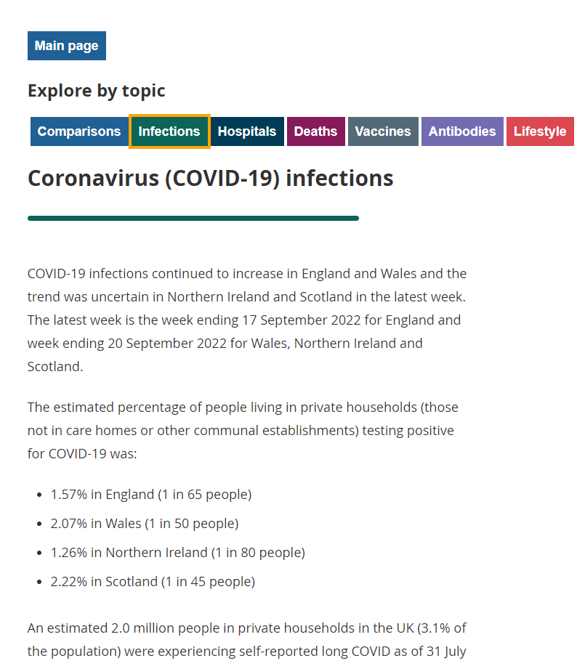
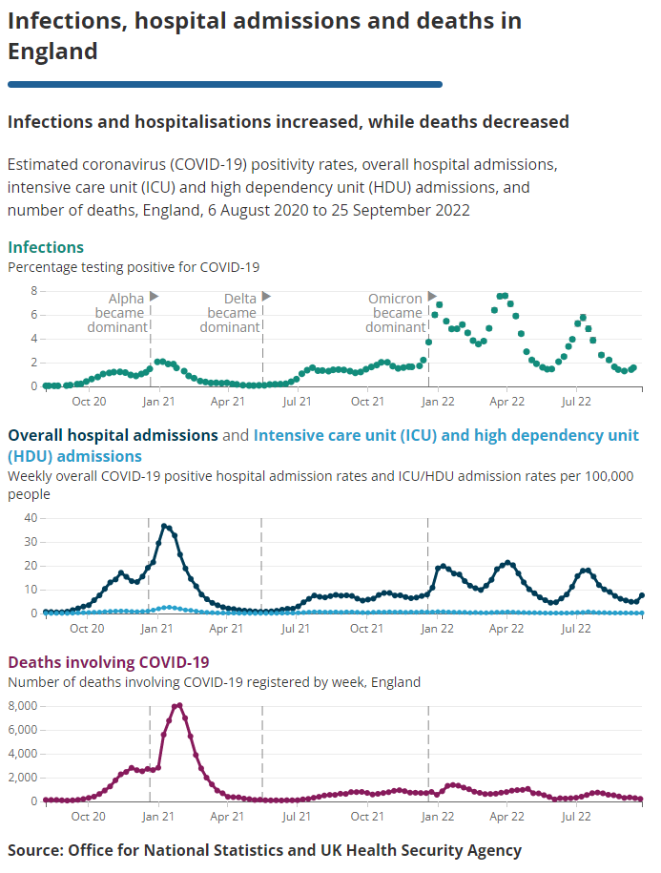
An example: Covid insights
https://www.ons.gov.uk/peoplepopulationandcommunity/healthandsocialcare/conditionsanddiseases/articles/coronaviruscovid19latestinsights/Overview

Slide 16
Thanks!
peter.broad@ons.gov.uk

